Slide 1
Sequential Minimal Optimization

Slide 2
PURPOSE OF THE PROJECT
The main purpose of this project is to compare different variations of the Sequential Minimal Optimization
algorithm employed to perform the training of the Support Vector Machine.
The optimization methods under investigation mainly differ in the way they select the Lagrange multipliers that compose the Working set
The aim of this project is to assess the performance of these training techniques over different dataset.
2018-2019
Nonlinear Optimization Project – Giovanni Vignocchi

Slide 3




WORKFLOW
General workflow of the project
The project was mainly divided in the following 4 sequential phases.
As the outcomes of some of these were different from what was expected, many cycles on these stages were carried out, in order to precisely tune the implemented algorithms.
PERFORMANCE
EVALUATION
IMPLEMENTATION
TESTING
ANALYSIS
The first part of the project consisted in the analysis of the SMO algorithm and in the study of the proposed papers.
The different optimization methods were implemented using MATLAB.
The implementations were initially tested on simple ‘’artificial’’ dataset to identify bugs and anomalies.
The final stage of the project consisted in the comparison of the algorithms’ performance on several dataset
2018-2019
Nonlinear Optimization Project – Giovanni Vignocchi

Slide 4
ANALYSIS
Introduction to Support Vector Machine
Formulation of the problem
Intrduction to Sequential Minimal Optimization
Working set selection methods

Slide 5

DEFINITION OF THE PROBLEM
There are many possible decision boundaries
that separate these two classes
The goal of the Support Vector Machine is to find the hyperplane that maximize the margin between the classes
Class 2
Class 2
m
Class 1
Class 1
2018-2019
Nonlinear Optimization Project – Giovanni Vignocchi

Slide 6
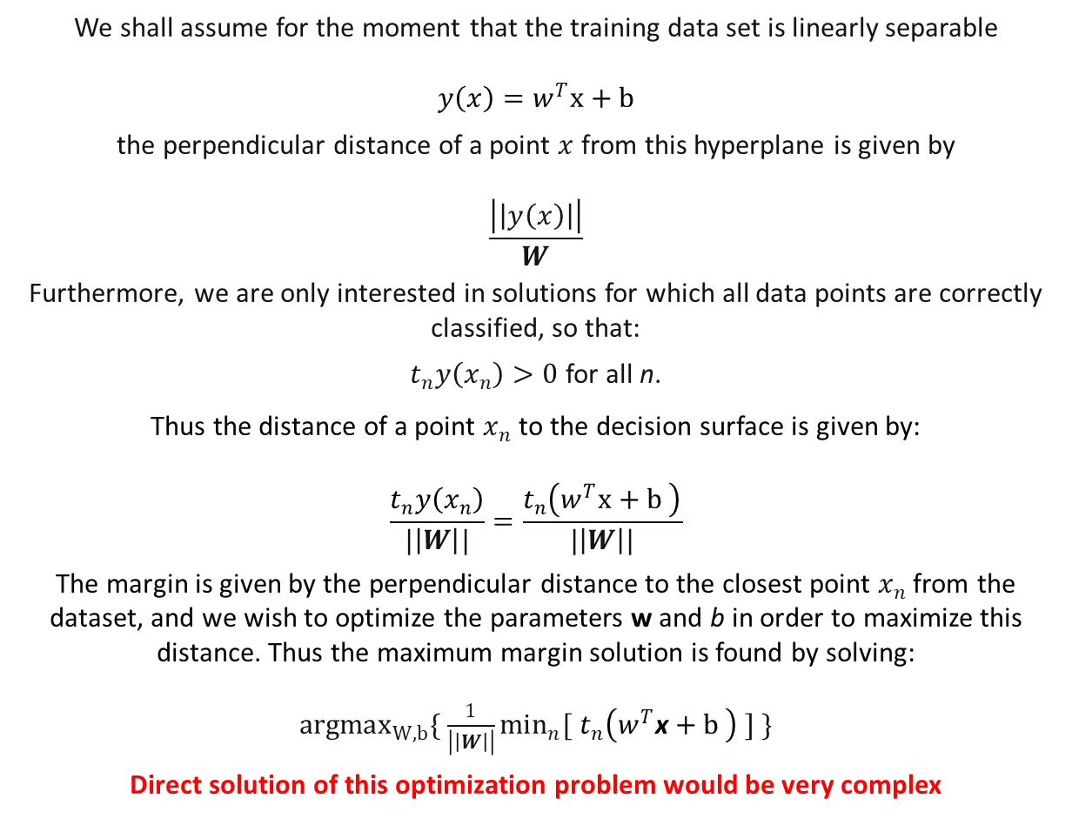
FORMULATION
We shall assume for the moment that the training data set is linearly separable
$$y\left(x\right)=w^{T}x+b$$
the perpendicular distance of a point $x$ from this hyperplane is given by
$$\frac{\left|\left|y\left(x\right)\right|\right|}{W}$$
Furthermore, we are only interested in solutions for which all data points are correctly classified, so that:
$t_{n}y\left(x_{n}\right)>0$ for all n.
Thus the distance of a point $x_{n}$ to the decision surface is given by:
$$\frac{t_{n}y\left(x_{n}\right)}{|\left|W\right||}=\frac{t_{n}\left(w^{T}x+b \right)}{|\left|W\right||}$$
The margin is given by the perpendicular distance to the closest point $x_{n}$ from the dataset, and we wish to optimize the parameters w and b in order to maximize this distance. Thus the maximum margin solution is found by solving:
${argmax}_{W, b}\{ \frac{1}{\left|\left|W\right|\right|}\min_{n}{[}$ $t_{n}\left(w^{T}\text{x}+b \right) ] \}$
Direct solution of this optimization problem would be very complex
m
2018-2019
Nonlinear Optimization Project – Giovanni Vignocchi

Slide 7
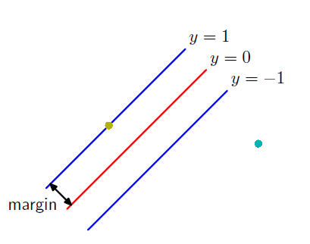
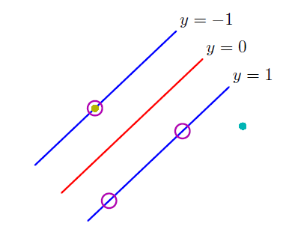
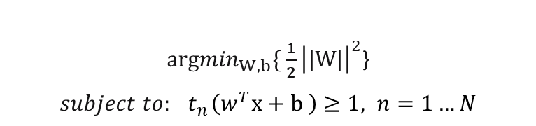
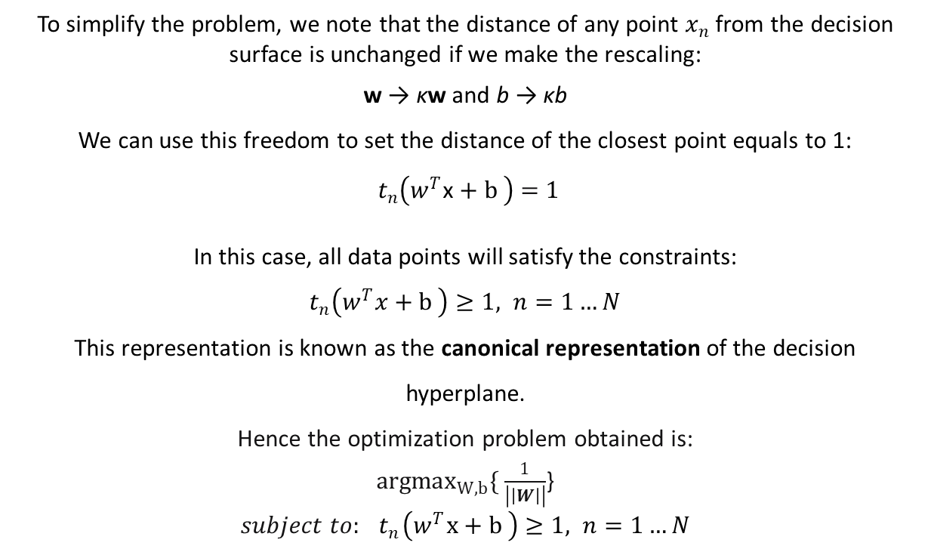
FORMULATION
To simplify the problem, we note that the distance of any point $x_{n}$ from the decision surface is unchanged if we make the rescaling:
w → κw and b → κb
We can use this freedom to set the distance of the closest point equals to 1:
$t_{n}\left(w^{T}\text{x}+b \right)$ $=$ $1$
In this case, all data points will satisfy the constraints:
$t_{n}\left(w^{T}x+b \right)$ $≥1, n=1…N$
This representation is known as the canonical representation of the decision hyperplane.
Hence the optimization problem obtained is:
${argmax}_{W, b}\{ \frac{1}{\left|\left|W\right|\right|}$}
$subject to:{ t}_{n}\left(w^{T}x+b \right)$ $≥1, n=1…N$
${argmin}_{W, b}\{ \frac{1}{2}{\left|\left|W\right|\right|}^{2}$}
$subject to:{ t}_{n}\left(w^{T}\text{x}+b \right)$ $≥1, n=1…N$
2018-2019
Nonlinear Optimization Project – Giovanni Vignocchi

Slide 8
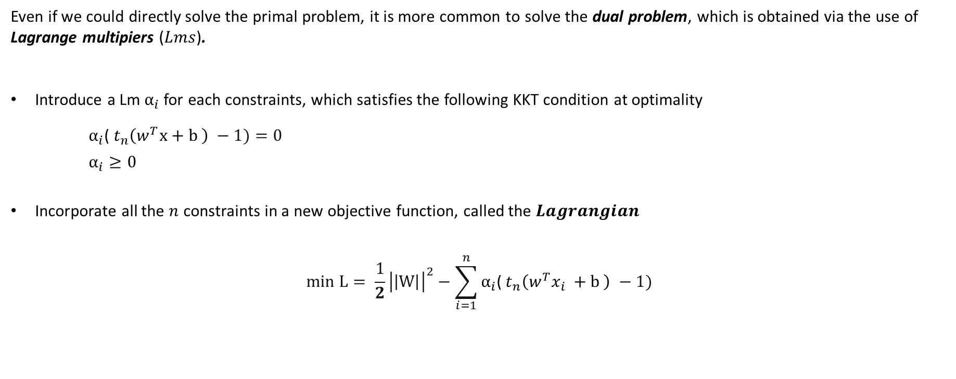
DUAL PROBLEM
Even if we could directly solve the primal problem, it is more common to solve the dual problem, which is obtained via the use of Lagrange multipiers ($Lms$).
Introduce a Lm $α_{i}$for each constraints, which satisfies the following KKT condition at optimality
$α_{i}$(${ t}_{n}\left(w^{T}\text{x}+b \right) −1)=0$
$α_{i}≥0$
Incorporate all the $n$ constraints in a new objective function, called the $Lagrangian$
$$min L= \frac{1}{2}{\left|\left|W\right|\right|}^{2}−\sum_{i=1}^{n}{α_{i}\text{(}{ t}_{n}\left(w^{T}x_{i} +b \right) −1)}$$
2018-2019
Nonlinear Optimization Project – Giovanni Vignocchi

Slide 9
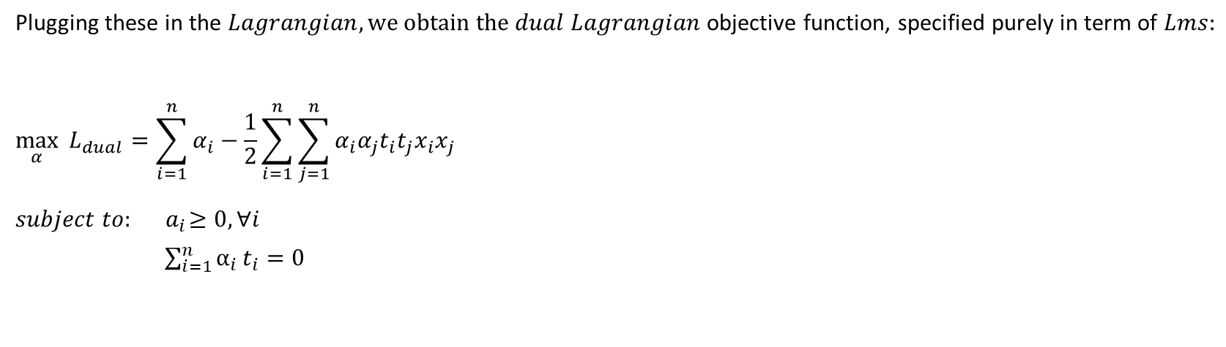
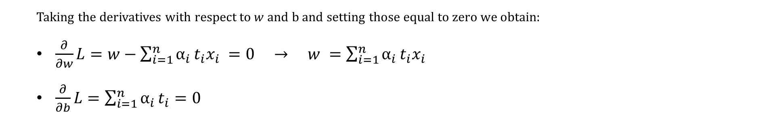
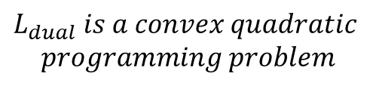
DUAL PROBLEM
Taking the derivatives with respect to $w$ and b and setting those equal to zero we obtain:
$\frac{∂}{∂w}L=w−\sum_{i=1}^{n}{α_{i}}t_{i}x_{i} =0 → w =\sum_{i=1}^{n}{α_{i}}t_{i}x_{i}$
$\frac{∂}{∂b}L=\sum_{i=1}^{n}{α_{i}}t_{i}=0$
Plugging these in the $Lagrangian, we obtain the$ $dual Lagrangian$objective function, specified purely in term of $Lms:$
$$\max_{α}{ L_{dual}=\sum_{i=1}^{n}{α_{i}−\frac{1}{2}\sum_{i=1}^{n}{\sum_{j=1}^{n}{α_{i}α_{j}t_{i}t_{j}x_{i}x_{j}}}} }$$
$$subject to: { a}_{i}≥0, ∀i$$
$\sum_{i=1}^{n}{α_{i}}t_{i}=0$
$$L_{dual} is a convex quadratic$$
$$programming problem$$
2018-2019
Nonlinear Optimization Project – Giovanni Vignocchi

Slide 10
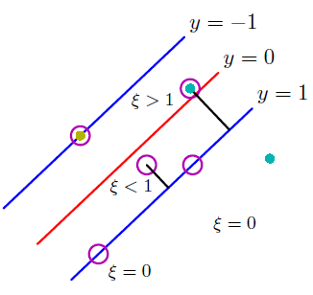
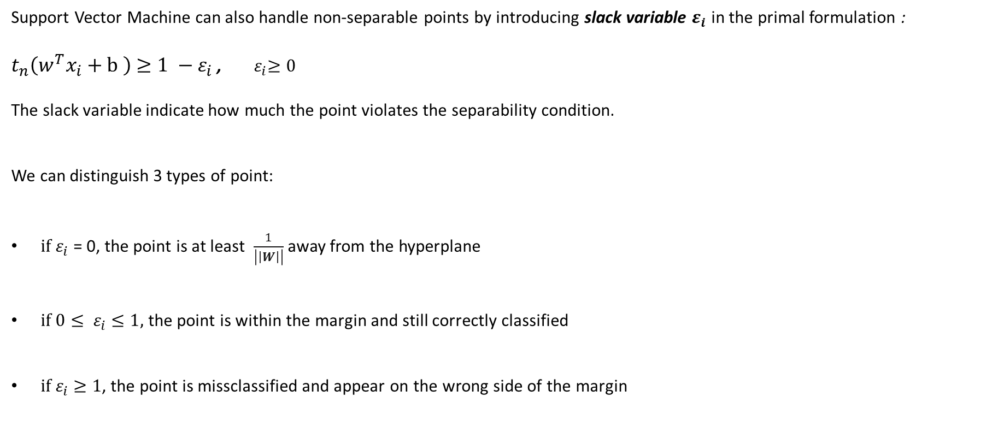
NON-SEPARABLE POINTS
Support Vector Machine can also handle non-separable points by introducing slack variable $ε_{i}$ in the primal formulation :
$t_{n}\left(w^{T}x_{i}+b \right)$ $≥1 −ε_{i}$ , ${ ε}_{i}≥0$
The slack variable indicate how much the point violates the separability condition.
We can distinguish 3 types of point:
${ if ε}_{i}$ = 0, the point is at least $\frac{1}{\left|\left|W\right|\right|}$ away from the hyperplane
${ if 0≤ ε}_{i} ≤1,$ the point is within the margin and still correctly classified
${ if ε}_{i} ≥1$, the point is missclassified and appear on the wrong side of the margin
2018-2019
Nonlinear Optimization Project – Giovanni Vignocchi

Slide 11
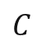
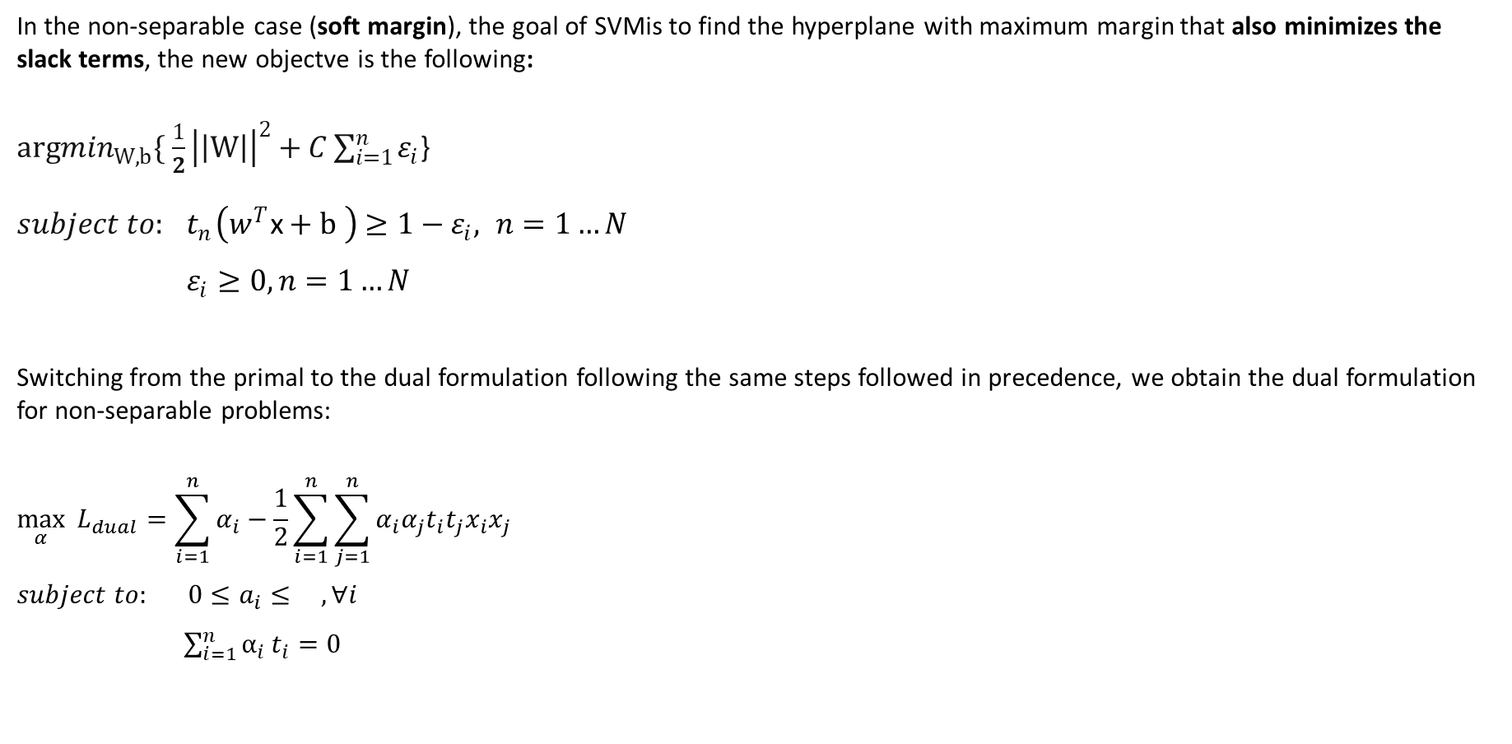
NON-SEPARABLE POINTS
In the non-separable case (soft margin), the goal of SVMis to find the hyperplane with maximum margin that also minimizes the slack terms, the new objectve is the following:
${argmin}_{W, b}\{ \frac{1}{2}{\left|\left|W\right|\right|}^{2}+C\sum_{i=1}^{n}{ε_{i}}$}
$subject to:{ t}_{n}\left(w^{T}\text{x}+b \right)$ $≥1−ε_{i}, n=1…N$
$ε_{i}≥0, n=1…N$
Switching from the primal to the dual formulation following the same steps followed in precedence, we obtain the dual formulation for non-separable problems:
$$\max_{α}{ L_{dual}=\sum_{i=1}^{n}{α_{i}−\frac{1}{2}\sum_{i=1}^{n}{\sum_{j=1}^{n}{α_{i}α_{j}t_{i}t_{j}x_{i}x_{j}}}} }$$
$$subject to: {0≤a}_{i}≤ , ∀i$$
$\sum_{i=1}^{n}{α_{i}}t_{i}=0$
$C$
2018-2019
Nonlinear Optimization Project – Giovanni Vignocchi

Slide 12

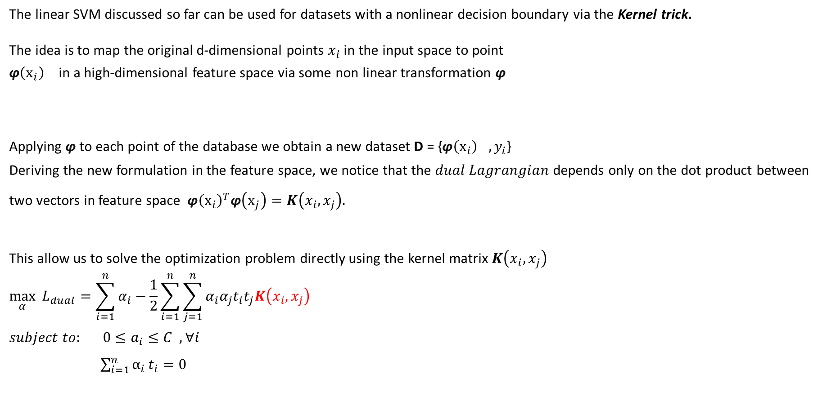
KERNEL TRICK
The linear SVM discussed so far can be used for datasets with a nonlinear decision boundary via the Kernel trick.
The idea is to map the original d-dimensional points $x_{i}$ in the input space to point
$\text{φ}{\left(x_{i}\right)}^{}$in a high-dimensional feature space via some non linear transformation $\text{φ}{}^{}$
Applying $\text{φ}$ to each point of the database we obtain a new dataset D = {$\text{φ}{\left(x_{i}\right)}^{},y_{i}$}
Deriving the new formulation in the feature space, we notice that the $dual Lagrangian$depends only on the dot product between two vectors in feature space $\text{φ}{\left(x_{i}\right)}^{T}\text{φ}\left(x_{j}\right)=K\left(x_{i},x_{j}\right).$
This allow us to solve the optimization problem directly using the kernel matrix $K\left(x_{i},x_{j}\right)$
$$\max_{α}{ L_{dual}=\sum_{i=1}^{n}{α_{i}−\frac{1}{2}\sum_{i=1}^{n}{\sum_{j=1}^{n}{α_{i}α_{j}t_{i}t_{j}K\left(x_{i},x_{j}\right)}}} }$$
$$subject to: {0≤a}_{i}≤C , ∀i$$
$\sum_{i=1}^{n}{α_{i}}t_{i}=0$
2018-2019
Nonlinear Optimization Project – Giovanni Vignocchi

Slide 13
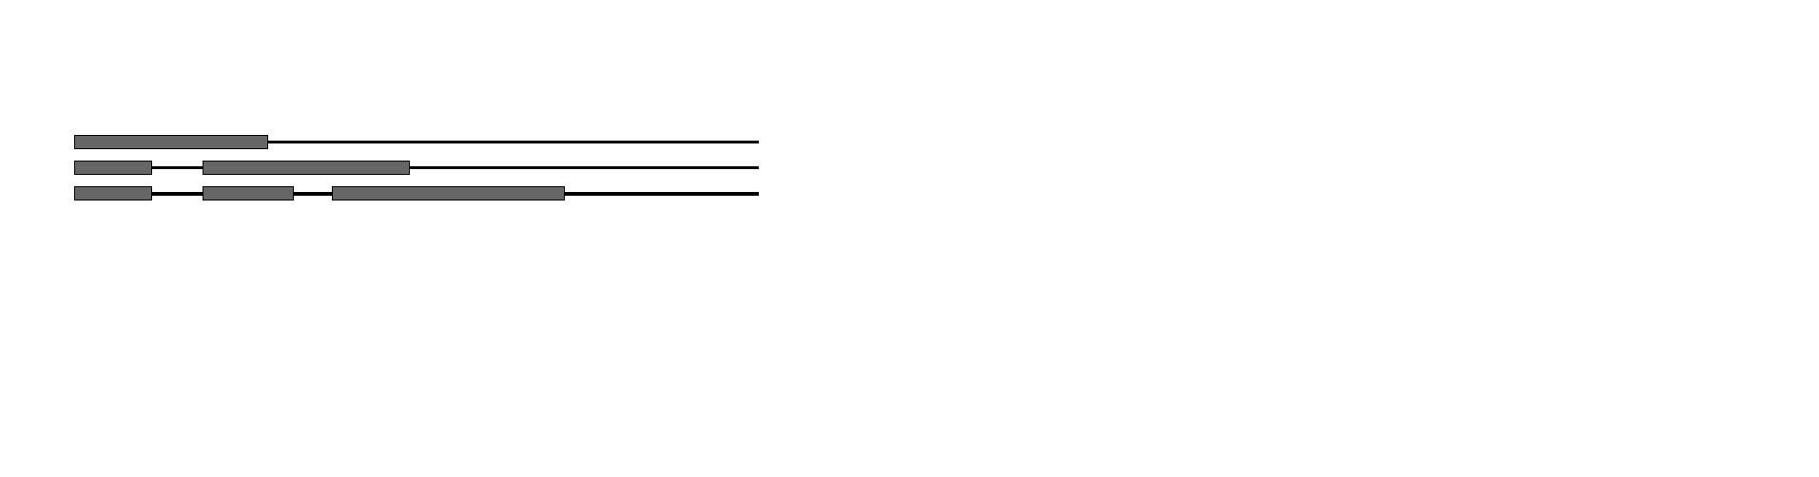

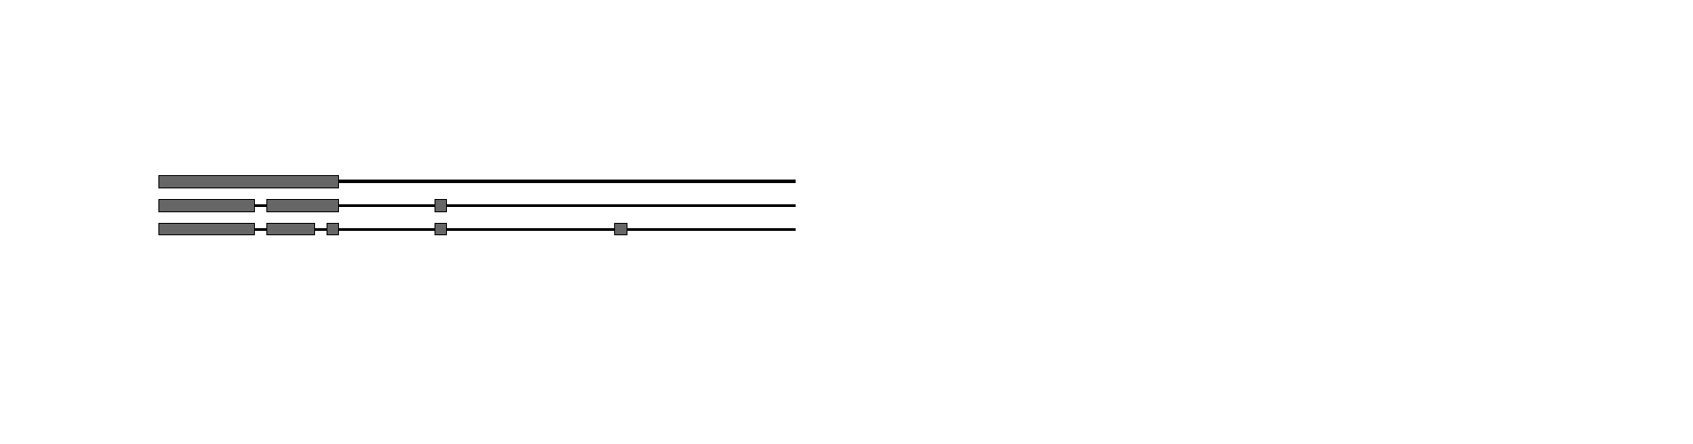
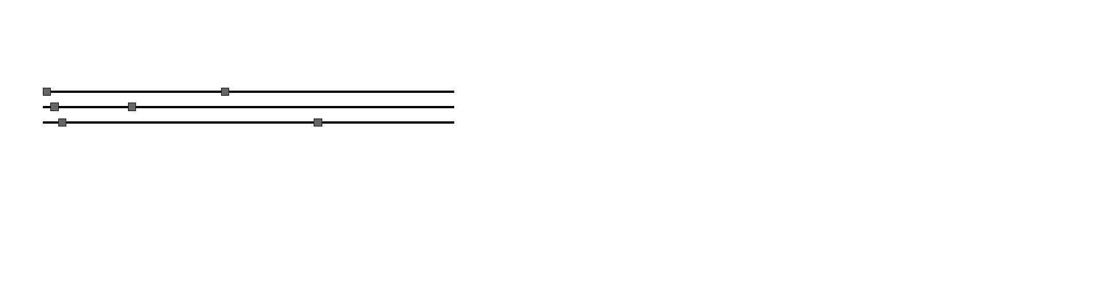
WHY SEQUENTIAL MINIMALO OPTIMIZATION
PROBLEM:
The quadratic form involves a matrix that has a number of elements equal to the square of the number of training examples.
CHUNKING
Removing columns and rows that correspond to zero Lagrange multipliers does not affect the value of the quadratic form
The QP problem can be broken down into a series of smaller QP problems
OSUNA
SEQUENTIAL MINIMAL OPTIMIZATION
2018-2019
Nonlinear Optimization Project – Giovanni Vignocchi

Slide 14
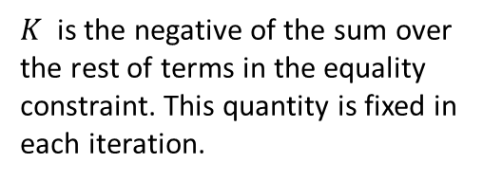
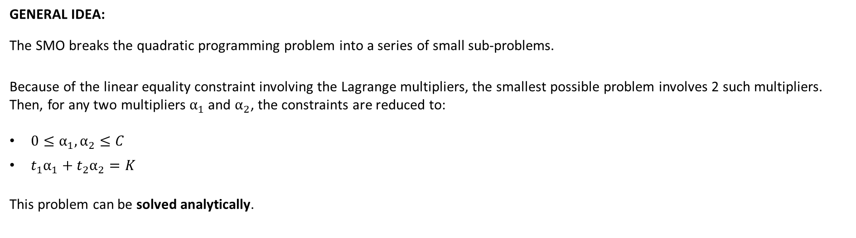
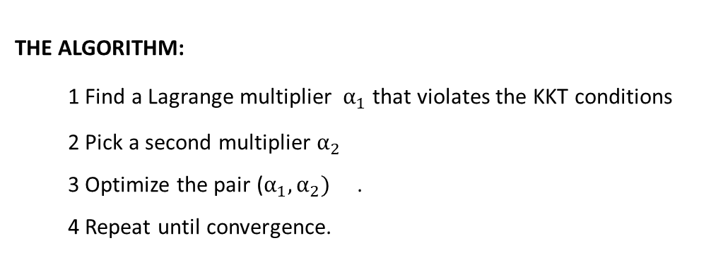
SEQUENTIAL MINIMAL OPTIMIZATION
GENERAL IDEA:
The SMO breaks the quadratic programming problem into a series of small sub-problems.
Because of the linear equality constraint involving the Lagrange multipliers, the smallest possible problem involves 2 such multipliers.
Then, for any two multipliers $α_{1}$ and $α_{2}$, the constraints are reduced to:
$0≤{α_{1}, α}_{2}≤C$
$t_{1}α_{1}+t_{2}α_{2}=K$
This problem can be solved analytically.
$K$ is the negative of the sum over the rest of terms in the equality constraint. This quantity is fixed in each iteration.
THE ALGORITHM:
1 Find a Lagrange multiplier $α_{1}$ that violates the KKT conditions
2 Pick a second multiplier $α_{2}$
3 Optimize the pair ($α_{1},α_{2})$ .
4 Repeat until convergence.
2018-2019
Nonlinear Optimization Project – Giovanni Vignocchi

Slide 15
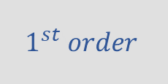

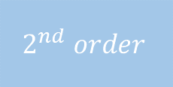
SEQUENTIAL MINIMAL OPTIMIZATION
From the previous general scheme, a lot of variations have been develped.
The optimization method analysed during this project along with their main charcateristics, can be summarized in the following table:
PLATT
KEERTHI
JOACHIMS
LIN
Working set
selection
SET OF
HEURISTICS
$$1^{st} order$$
$$1^{st} order$$
$$2^{nd} order$$
Working set
size
2
2
VARIABLE
SIZE
2
Optimization
step
ANALYTIC
METHOD
ANALYTIC
METHOD
QUADRATIC*
SOLVER
ANALYTIC
METHOD
2018-2019
Nonlinear Optimization Project – Giovanni Vignocchi

Slide 16
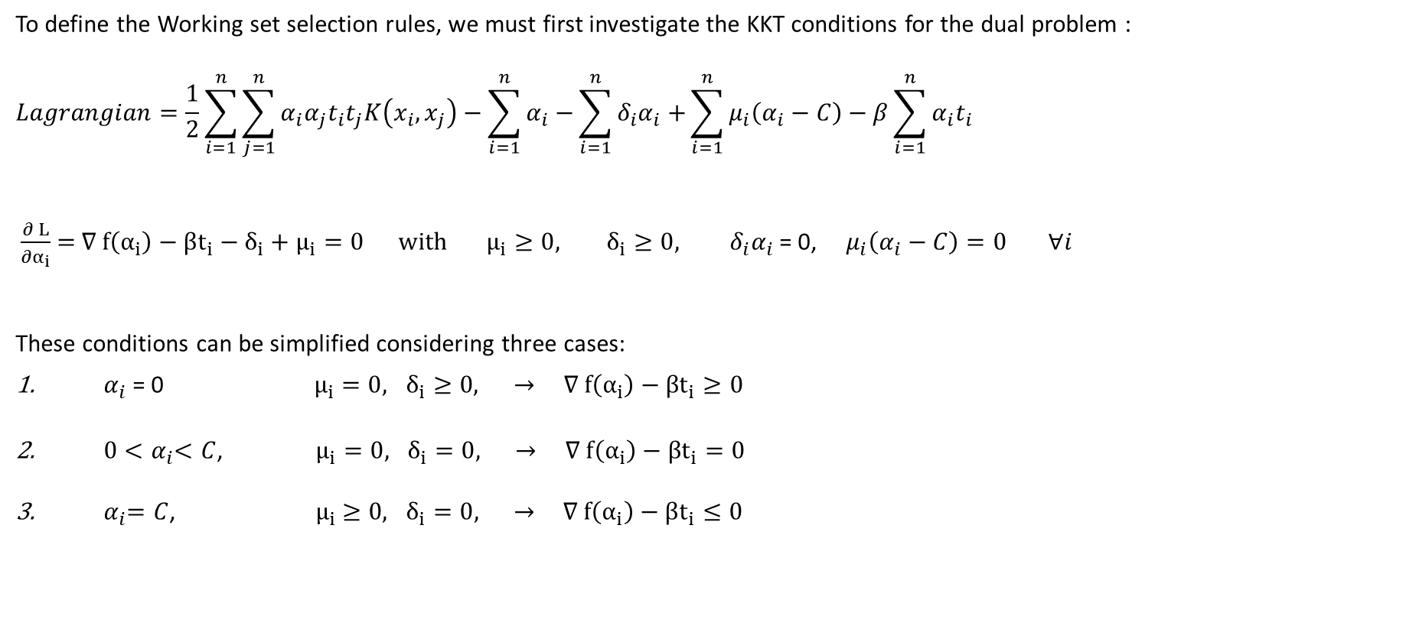
KKT CONDITIONS
To define the Working set selection rules, we must first investigate the KKT conditions for the dual problem :
$$Lagrangian=\frac{1}{2}\sum_{i=1}^{n}{\sum_{j=1}^{n}{α_{i}α_{j}t_{i}t_{j}K\left(x_{i},x_{j}\right)}}−\sum_{i=1}^{n}{α_{i}−}\sum_{i=1}^{n}{{δ_{i}α}_{i}+}\sum_{i=1}^{n}{μ_{i}\left(α_{i}−C\right)−β\sum_{i=1}^{n}{α_{i}t_{i}}}$$
$\frac{∂ L}{∂α_{i}}$ = ∇ $f\left(α_{i}\right)−βt_{i}−δ_{i}$ + $μ_{i}=0 with μ_{i}≥0, δ_{i}≥0, { { δ}_{i}α}_{i}$ = 0, $μ_{i}\left(α_{i}−C\right)=0$ $∀i$
These conditions can be simplified considering three cases:
${ α}_{i}$ = 0 $μ_{i}=0, δ_{i}≥0,$ $→$ ∇ $f\left(α_{i}\right)−βt_{i}≥0$
${ 0<α}_{i}<C$, $μ_{i}=0, δ_{i}=0,$ $→$ ∇ $f\left(α_{i}\right)−βt_{i}=0$
${ α}_{i}=C$, ${ μ}_{i} ≥0, δ_{i}=0,$ $→$ ∇ $f\left(α_{i}\right)−βt_{i}≤0$
2018-2019
Nonlinear Optimization Project – Giovanni Vignocchi

Slide 17
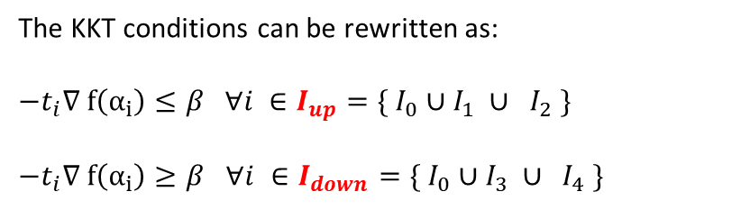
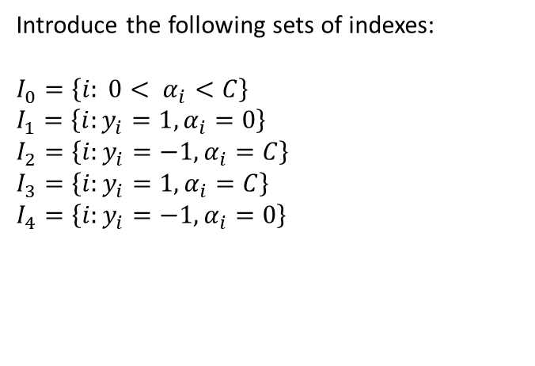
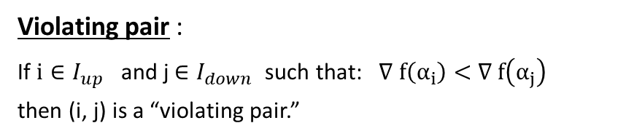
KKT CONDITIONS
Introduce the following sets of indexes:
$$I_{0}=\left\{i: 0< α_{i}<C\right\}$$
$$I_{1}=\left\{i:y_{i}=1, α_{i}=0\right\}$$
$$I_{2}=\left\{i:y_{i}=−1, α_{i}=C\right\}$$
$$I_{3}=\left\{i:y_{i}=1, α_{i}=C\right\}$$
$$I_{4}=\left\{i:y_{i}=−1, α_{i}=0\right\}$$
The KKT conditions can be rewritten as:
$−t_{i}$∇ $f\left(α_{i}\right)≤β ∀i ∈{I_{up}=\{ I}_{0}∪I_{1} ∪ I_{2} \}$
$−t_{i}$∇ $f\left(α_{i}\right)≥β$ $∀i ∈I_{down}=\{ I_{0}∪I_{3} ∪ I_{4} \}$
Violating pair :
If $i∈{I_{up}}_{}$and j$∈I_{down}$ such that: ∇ $f\left(α_{i}\right)<$ ∇ $f\left(α_{j}\right)$
then (i, j) is a “violating pair.”
The optimality conditions will hold iff there does not exist any index pair (i, j) that defines a violation
2018-2019
Nonlinear Optimization Project – Giovanni Vignocchi

Slide 18
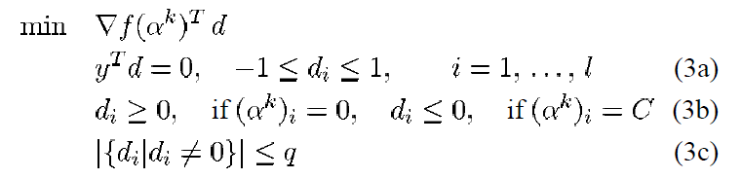
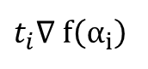
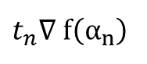
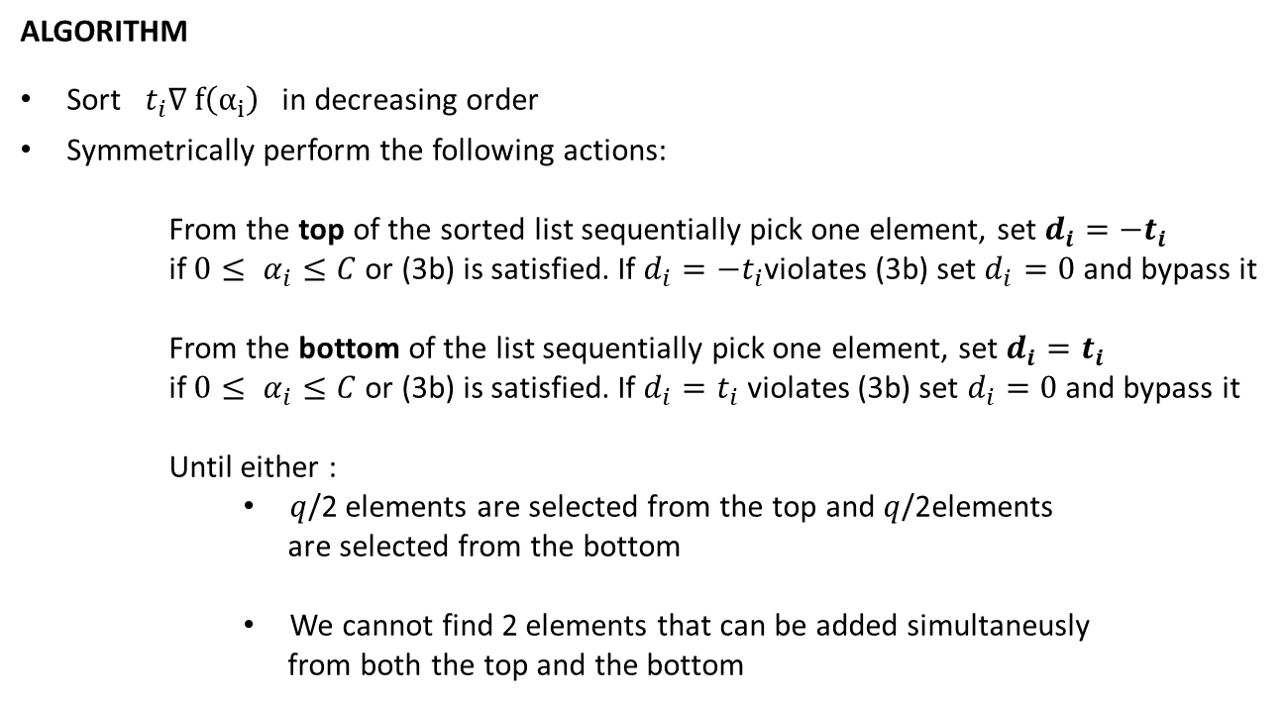
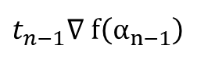
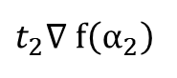

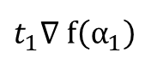
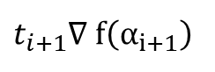
JOACHIMS
ALGORITHM
Sort $t_{i}$∇ $f\left(α_{i}\right)$ in decreasing order
Symmetrically perform the following actions:
From the top of the sorted list sequentially pick one element, set $d_{i}=−t_{i}$
if $0≤ α_{i}≤C$ or (3b) is satisfied. If $d_{i}=−t_{i}$violates (3b) set $d_{i}=0$ and bypass it
From the bottom of the list sequentially pick one element, set $d_{i}=t_{i}$
if $0≤ α_{i}≤C$ or (3b) is satisfied. If $d_{i}=t_{i}$ violates (3b) set $d_{i}=0$ and bypass it
Until either :
$q$/2 elements are selected from the top and $q$/2elements
are selected from the bottom
We cannot find 2 elements that can be added simultaneusly
from both the top and the bottom
Complexity: $O(n ln⁡(n))$
$t_{1}$∇ $f\left(α_{1}\right)$
$t_{2}$∇ $f\left(α_{2}\right)$
$t_{i}$∇ $f\left(α_{i}\right)$
$t_{i+1}$∇ $f\left(α_{i+1}\right)$
$t_{n−1}$∇ $f\left(α_{n−1}\right)$
$t_{n}$∇ $f\left(α_{n}\right)$
2018-2019
Nonlinear Optimization Project – Giovanni Vignocchi

Slide 19
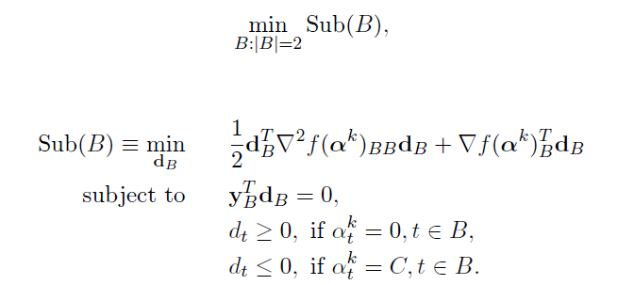
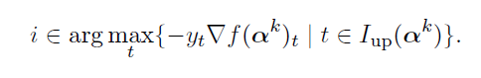
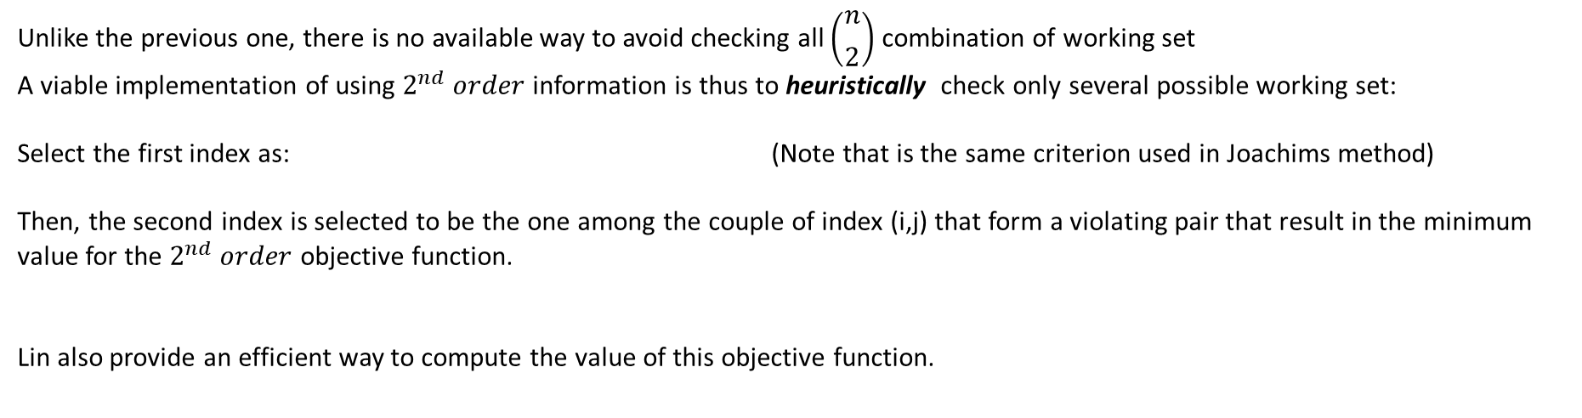
LIN
Insted of using $1^{st} order$ approximation method, Lin consider a more accurate $2^{nd} order$ information:
Unlike the previous one, there is no available way to avoid checking all $\left(\begin{aligned}n \\ \begin{matrix} \\ 2\end{matrix}\end{aligned}\right)$ combination of working set
A viable implementation of using $2^{nd} order$ information is thus to heuristically check only several possible working set:
Select the first index as: (Note that is the same criterion used in Joachims method)
Then, the second index is selected to be the one among the couple of index (i,j) that form a violating pair that result in the minimum value for the $2^{nd} order$ objective function.
Lin also provide an efficient way to compute the value of this objective function.
2018-2019
Nonlinear Optimization Project – Giovanni Vignocchi

Slide 20
IMPLEMENTATION

Slide 21
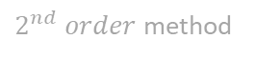


IMPLEMENTATION
PLATT
PLAIN IMPLEMENTATION
KEERTHI
JOACHIMS
LIN
ERROR CACHE
$1^{st} order$ method
$1^{st} order$ method
$2^{nd} order$ method
For each version of the algorithm a different Matlab class has been implemented.
Each of these offer methods to implement the following operations:
Instantiate a model of the selected type, with the possibility to specified a set of characteristics parameters
Select the type of kernel (linear, polynomial, gaussian) and set the proper parameters
Training the model using the target proceure
Making new prediction using the generated model
2018-2019
Nonlinear Optimization Project – Giovanni Vignocchi

Slide 22
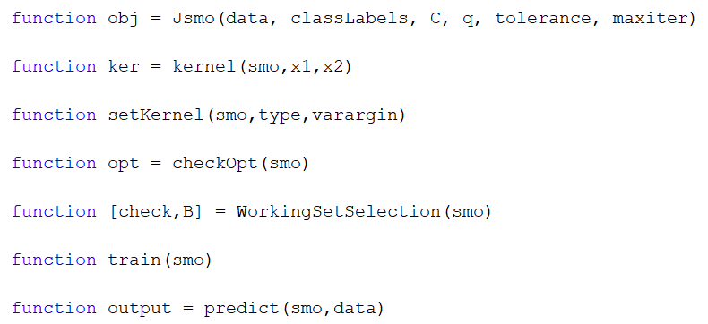
JOACHIMS
1 order method
The parameter q set the size of the Working set
2018-2019
Nonlinear Optimization Project – Giovanni Vignocchi

Slide 23
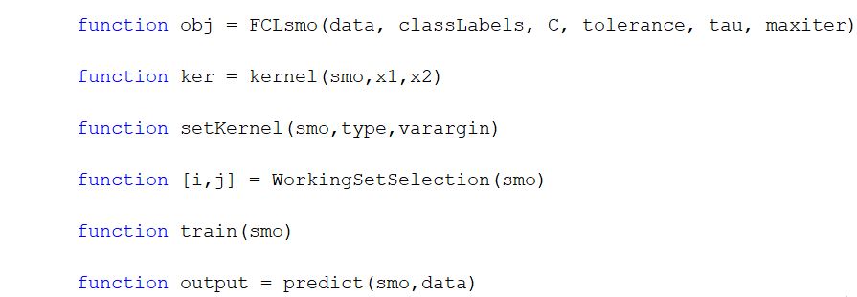
LIN
2 order method
2018-2019
Nonlinear Optimization Project – Giovanni Vignocchi

Slide 24
TESTING

Slide 25
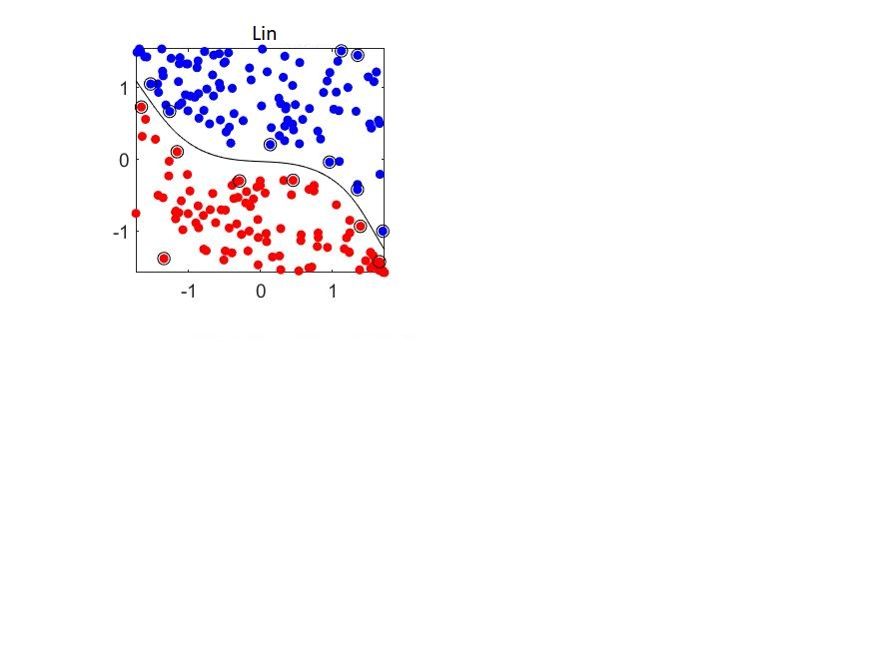
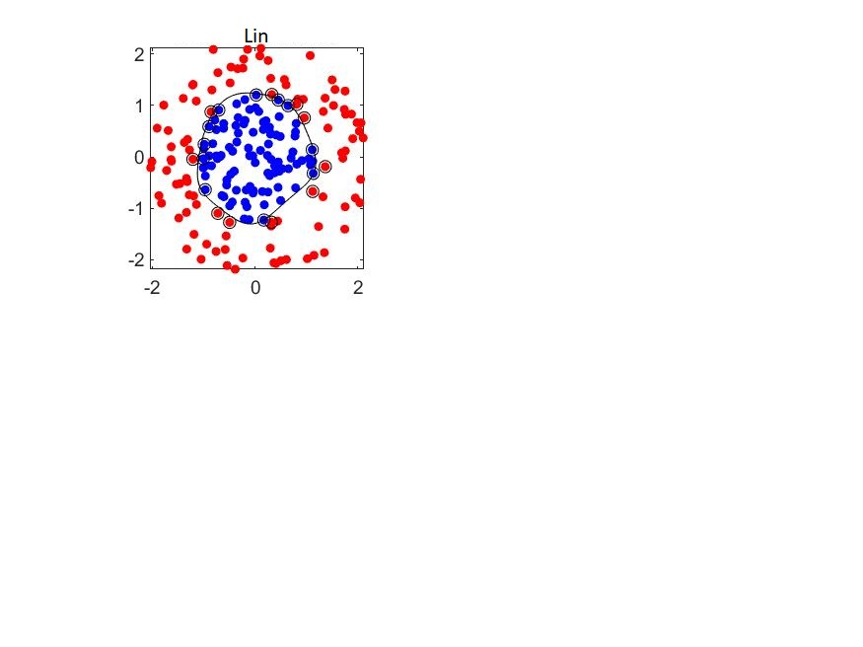
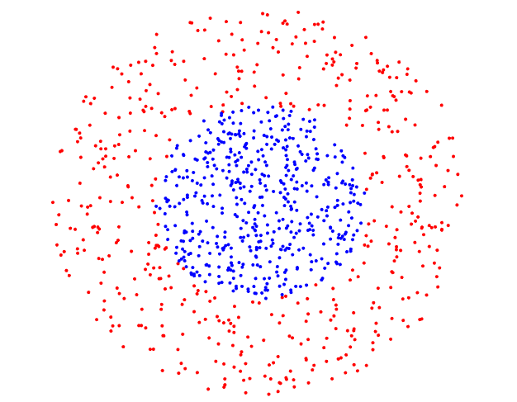
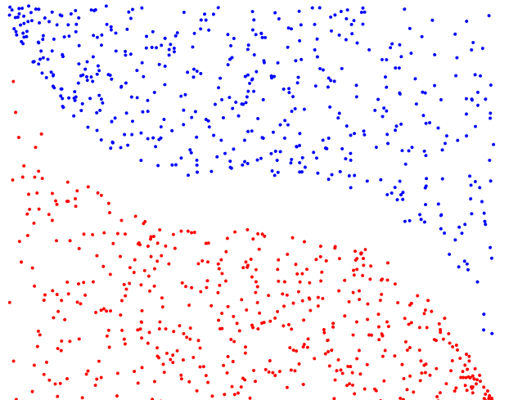
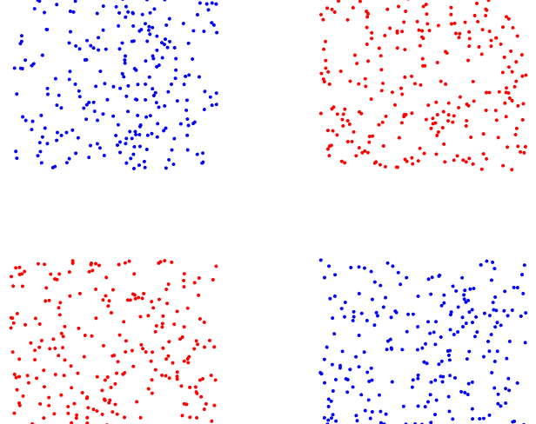
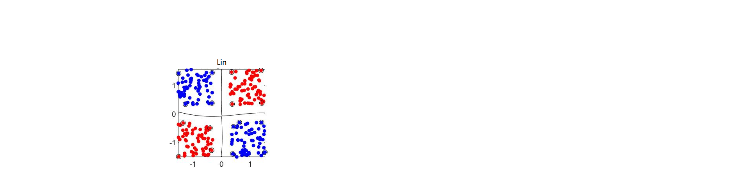
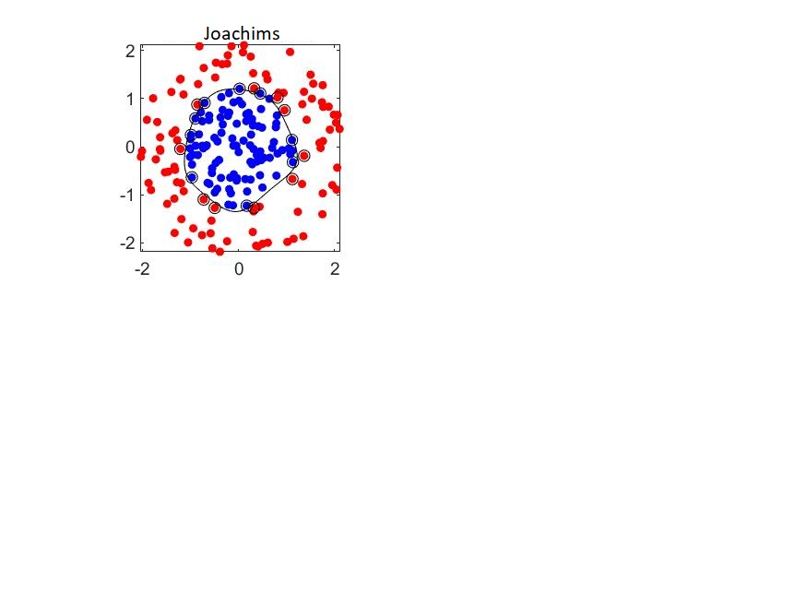
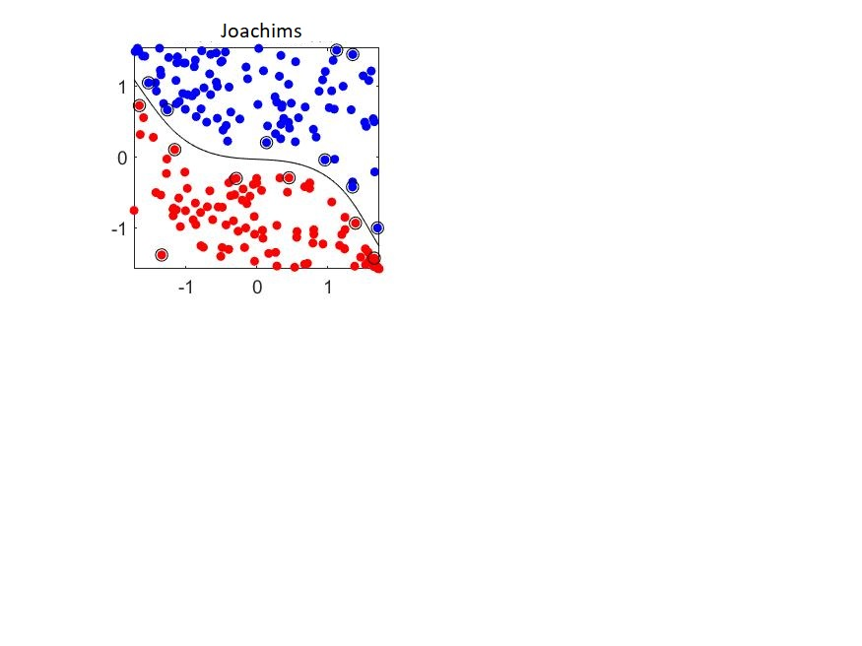
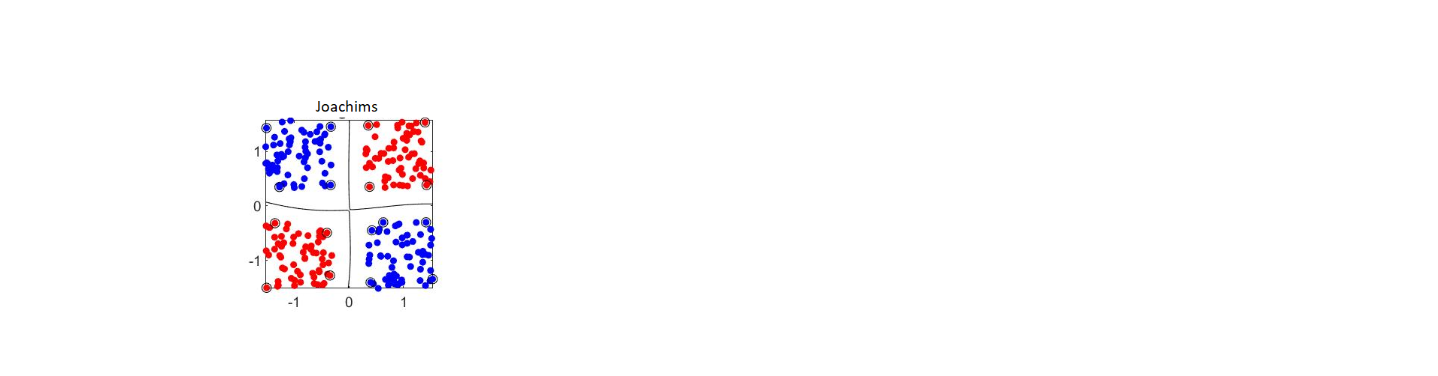


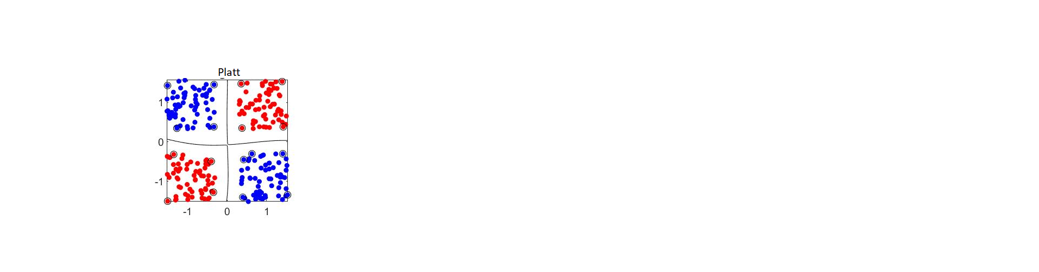
TESTING
The testing phase was carried out using a set of manually generated 2-dimensional dataset data.
To test the correctness of the implementations, the resutlts obtained were cecked against the models generated by the Matlab function that train Support Vector Machine (fitcsvm).
The test phase was repeated both on perfectly separable data and . . .
2018-2019
Nonlinear Optimization Project – Giovanni Vignocchi

Slide 26








TESTING
And not perfectly separable data
2018-2019
Nonlinear Optimization Project – Giovanni Vignocchi

Slide 27
PERFORMANCE EVALUATION

Slide 28

PERFORMANCE AND EVALUATION
The main focus of this project is to compare performance of $1^{st}$and $2^{nd} order working set selection method.$
WORKING SET SIZE
4
JOACHIMS
WORKING SET SIZE
6
LIN
2018-2019
Nonlinear Optimization Project – Giovanni Vignocchi

Slide 29




EVALUATION SETTINGS
The evaluation of the methods was repeated on five dataset with different number of instances and features
For each dataset the training procedure was repeated testing different combination of parameters:
$C$ (Box-constraint)
$σ (gaussian kernel span)$
 | FEATURES | INSTANCES
DIABETES | 8 | 0.5 K
RINGNORM | 20 | 6.5 K
MAGIC | 10 | 17.1 K
A9A | 124 | 12.6 K
CODRNA | 8 | 59.5 K
$$C$$
$$σ$$
2018-2019
Nonlinear Optimization Project – Giovanni Vignocchi

Slide 30
DIABETES
2018-2019
Nonlinear Optimization Project – Giovanni Vignocchi

Slide 31




RESULTS - DIABETES
$${C=2}^{−5}$$
$${C=2}^{−3}$$
2018-2019
Nonlinear Optimization Project – Giovanni Vignocchi

Slide 32




RESULTS - DIABETES
$${C=2}^{}$$
$${C=2}^{7 }$$
2018-2019
Nonlinear Optimization Project – Giovanni Vignocchi

Slide 33




RESULTS - DIABETES
$${C=2}^{9}$$
$${C=2}^{15}$$
2018-2019
Nonlinear Optimization Project – Giovanni Vignocchi

Slide 34
RINGNORM
2018-2019
Nonlinear Optimization Project – Giovanni Vignocchi

Slide 35



RESULTS - RINGNORM
$${C=2}^{−5}$$
$${C=2}^{−3}$$
2018-2019
Nonlinear Optimization Project – Giovanni Vignocchi

Slide 36



RESULTS - RINGNORM
$${C=2}^{}$$
$${C=2}^{7}$$
2018-2019
Nonlinear Optimization Project – Giovanni Vignocchi

Slide 37

RESULTS - RINGNORM
$${C=2}^{9}$$
2018-2019
Nonlinear Optimization Project – Giovanni Vignocchi

Slide 38
MAGIC
2018-2019
Nonlinear Optimization Project – Giovanni Vignocchi

Slide 39




RESULTS - MAGIC
$${C=2}^{−3}$$
$${C=2}^{}$$
2018-2019
Nonlinear Optimization Project – Giovanni Vignocchi

Slide 40

RESULTS - MAGIC
$${C=2}^{9}$$
2018-2019
Nonlinear Optimization Project – Giovanni Vignocchi

Slide 41
A9A
2018-2019
Nonlinear Optimization Project – Giovanni Vignocchi

Slide 42



RESULTS – A9A
$${C=2}^{−3}$$
$${C=2}^{}$$
2018-2019
Nonlinear Optimization Project – Giovanni Vignocchi

Slide 43


RESULTS – A9A
$${C=2}^{7}$$
2018-2019
Nonlinear Optimization Project – Giovanni Vignocchi

Slide 44
CODRNA
2018-2019
Nonlinear Optimization Project – Giovanni Vignocchi

Slide 45


RESULTS – CODRNA
$$Sigma$$
$$3.25$$
2018-2019
Nonlinear Optimization Project – Giovanni Vignocchi

Slide 46

CONCLUSIONS

Slide 47
CONCLUSIONS
The datasets analyzed have different characteristics in term of number of instances and features.
diabetes (8 features, 576 instances)
ringnorm (20 features, 6500 instances)
magic (10 features, 17118 instances)
a9a (124 features, 12682 instances)
codrna (8 features, 59535 instances)
The data collected highlight how the kind of dataset on which the training is carried out has a strong impact on the performance of the Sequential Minimal Optimization algorithm:
Increasing order of
‘’complexity’’
In datasets composed of a relatively low number of instances or features the first order method has better performance in terms of training time than those obtained using a second order method.
For the remaining two datasets the choice of using the second order method gives us better performance, as expected.
2018-2019
Nonlinear Optimization Project – Giovanni Vignocchi

